Slide 1
Relation between Neural Activity and Personality during Working Memory Task in the HCP Dataset
By:, Keyi Huang, Yuhan Huang, Na-yeong Jeong, Niklas Koeppe, Alex Qin, Jasraj Singh, Anh Hang Mai Vo, Yoyo Yuan
Almas_Wiggle / NeuroTraitMind 🧠
*alphabetical order
Notes:
Our team, Neurotraitmind explored the relation between neural actitivy and personality during working memory task in the hcp dataset.
our team members names are here, and Im na-yeong jeong who’s gonna start with the introduction part.

Slide 2
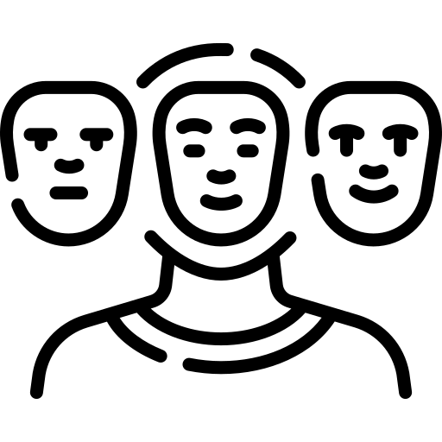






✨ Introduction
Research Question
Is there a correlation between Personality traits and neural activity during the Working Memory task?
Personality traits
Working Memory
O
Neural Signals
C
N
Big5
0-back
2-back
E
A
Notes:
First of all, regarding our teammates’ research interests, our research question was decided like this.
Is there a correlation between petsonality traits and neural activity during WM task?
Here, Big 5 personality describes individual personality characteristics, and working memory is a memory system which can hold information temporaily.

Slide 3
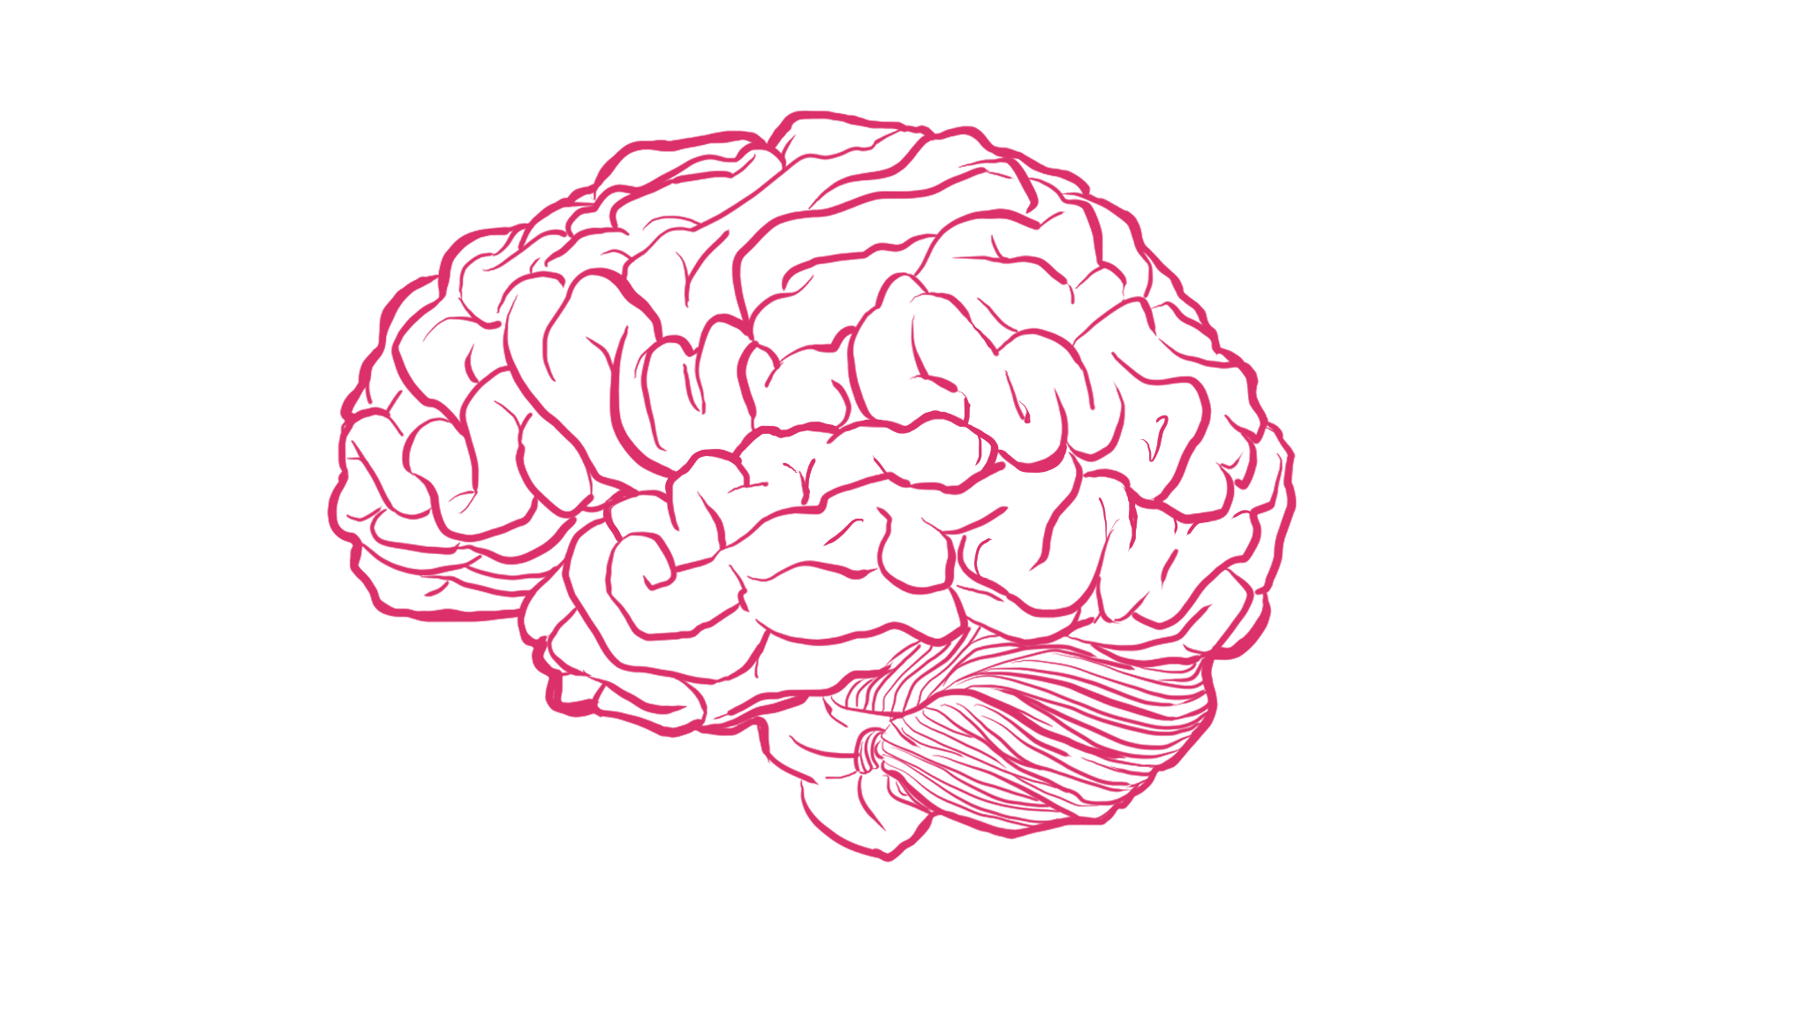
📃 Background Literature
Neural correlates of the Big 5 Personality traits and the default mode network (DMN) were explored in previous studies [1]
Relation between behavior approach sensitivity (BAS) & behavior inhibition sensitivity (BIS) and Working Memory task was revealed by the neural activity in the caudal anterior cingulate cortex (ACC). [2]
However, several researches failed to find a robust association between them, while Conscientiousness and Openness showed a negative relation with only n-back task [3-4]
Posterior parietal and prefrontal cortex showed significant activity during Working memory task [5-6]
Hypothesis: Higher Neuroticism is related to distinctive neural activity during Working Memory task (especially in the ACC, posterior parietal, and prefrontal cortex)
[1] Sampaio, A., Soares, J. M., Coutinho, J., Sousa, N., & Gonçalves, Ó. F. (2014). The Big Five default brain: functional evidence. Brain Structure and Function, 219, 1913-1922.
[2] Gray, J. R., & Braver, T. S. (2002). Personality predicts working-memory—related activation in the caudal anterior cingulate cortex. Cognitive, Affective, & Behavioral Neuroscience, 2(1), 64-75
[3] DeYoung, C. G., Shamosh, N. A., Green, A. E., Braver, T. S., & Gray, J. R. (2009). Intellect as distinct from Openness: differences revealed by fMRI of working memory. Journal of personality and social psychology, 97(5), 883.
[4] Waris, O., Soveri, A., Lukasik, K. M., Lehtonen, M., & Laine, M. (2018). Working memory and the Big Five. Personality and Individual Differences, 130, 26-35.
[5] Öztekin, I., McElree, B., Staresina, B. P., & Davachi, L. (2009). Working memory retrieval: contributions of the left prefrontal cortex, the left posterior parietal cortex, and the hippocampus. Journal of cognitive neuroscience, 21(3), 581-593.
[6] Curtis, C. E., & D'Esposito, M. (2003). Persistent activity in the prefrontal cortex during working memory. Trends in cognitive sciences, 7(9), 415-423.
Notes:
We examined the background literature to specify our hypothesis.
Neural correlates of Big5 and a certain network were revealed,
and also we could find that neural activity of ACC showed the relation between behavior approach/behavior inhibition sensitivity and working memory task.
However, several researches failed to find a robust association between them.
Then, using previous findings that posterior parietal and prefrontal cortex are related to working memory,
we decided to find out if neuroticism, which is similar to BIS, is related to higher neural activity in some areas proven to be related to working memory, during our working memory task, n-back.

Slide 4
🔢 Dataset
For our analysis we chose the Task fMRI HCP 2021 + behavior dataset
the data is already preprocessed and averaged across voxels to make brain regions
100 subjects
We are interested in the working memory and personality data
Working Memory (WM):
Task fMRI
0-back and 2-back task with 4 different visual stimuli (bodies, faces, places, tools)
Personality: Big Five Personality Traits
(Agreeableness, Openness, Conscientiousness, Extroversion, Neuroticism)
Numeral, from 0-50, discrete

Slide 5
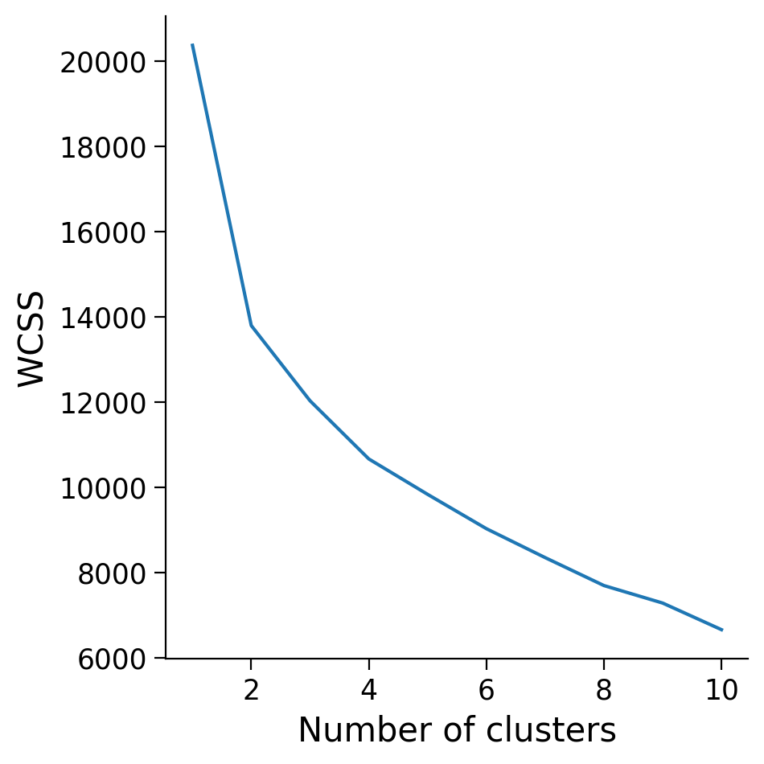
📊 Personality Trait Clustering
We tried different approaches (PCA, K-means, TSNE) to separate the subjects into different groups
Ended up using K-means (k=2) as it produced two groups with statistically significant different traits which also matched our hypothesis
One group showed low Neuroticism
One group showed high Neuroticism
Notes:
Calculate Within-Cluster Sum of Squares (WCSS): For each value of K, compute the sum of squared distances between each data point and its assigned cluster centroid. This value is known as the Within-Cluster Sum of Squares (WCSS).
The goal is to find the "elbow point" on the plot, which is the point where the rate of WCSS decrease starts to slow down significantly.
Choose the Elbow Point: The elbow point represents the optimal number of clusters where adding more clusters does not significantly reduce WCSS. Selecting the number of clusters at the elbow point strikes a balance between capturing meaningful patterns without overfitting the data.

Slide 6
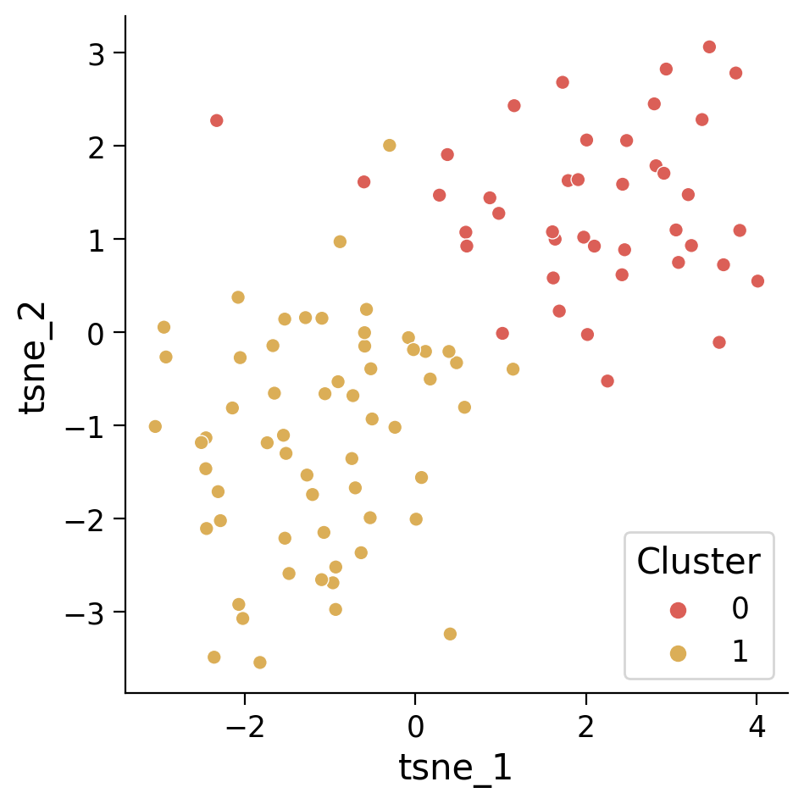
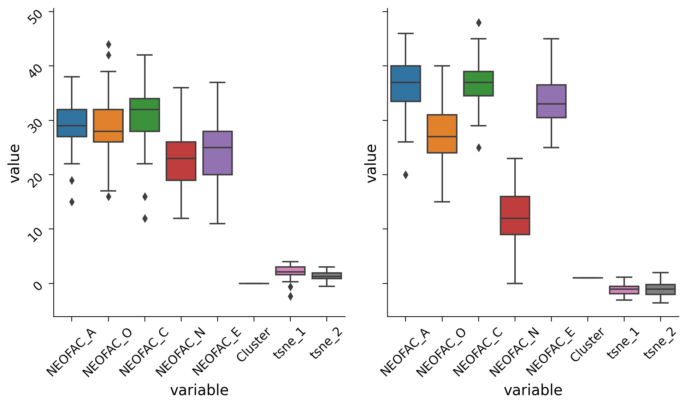
📊 Personality Trait Clustering
Notes:
Calculate Within-Cluster Sum of Squares (WCSS): For each value of K, compute the sum of squared distances between each data point and its assigned cluster centroid. This value is known as the Within-Cluster Sum of Squares (WCSS).
The goal is to find the "elbow point" on the plot, which is the point where the rate of WCSS decrease starts to slow down significantly.
Choose the Elbow Point: The elbow point represents the optimal number of clusters where adding more clusters does not significantly reduce WCSS. Selecting the number of clusters at the elbow point strikes a balance between capturing meaningful patterns without overfitting the data.

Slide 7
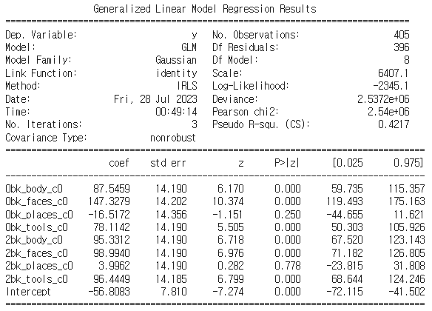
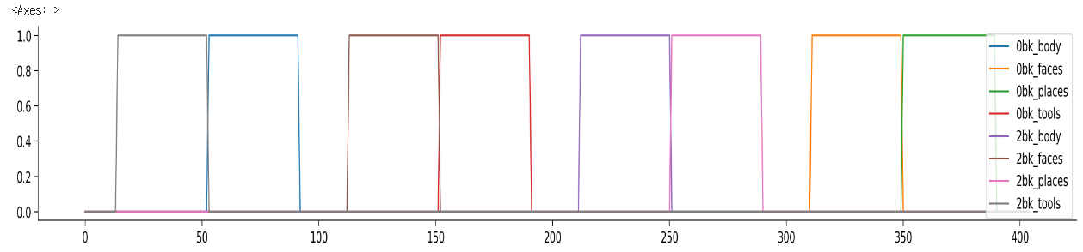
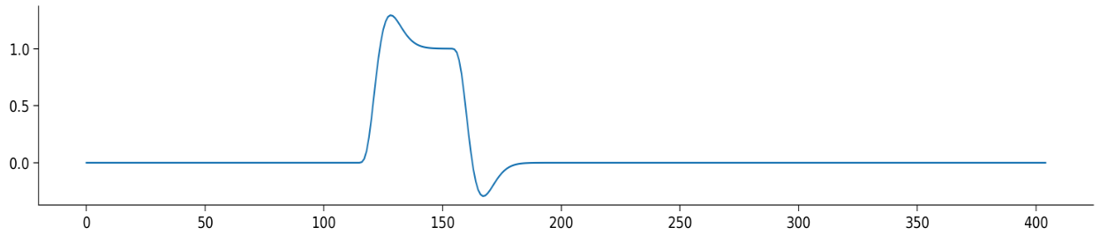
📈 General Linear Model Analysis
We used the General Linear Model (GLM) to encode the neural activity of each individual subject during the WM task
Each GLM has 9 regressors
1 for each condition + 1 bias regressor
Block diagram including all 8 conditions
Ideal time series of 2-back body condition (HRF convolved)
GLM result example for one subject & one brain parcel

Slide 8
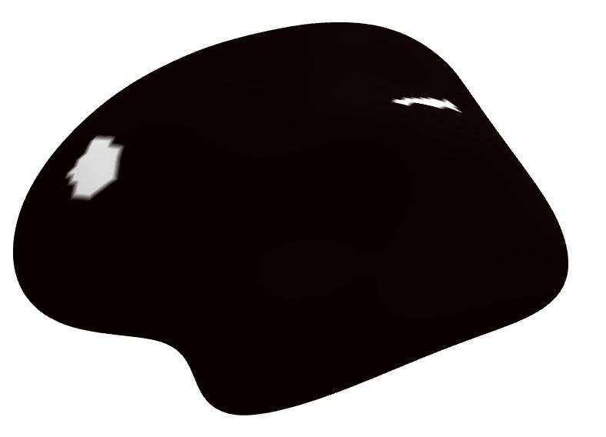
📝 Initial Data Analysis
To investigate the differences in brain activity within ROIs between 2-back and 0-back for four conditions across subjects.
Based on the GLM results, we took the differences for each ROI in each subject between 2-back and 0-back for each condition.
Under each condition, one-sample t-tests were used on all subjects’ differences for each ROI.
We found several ROIs with statistically significant differences for each condition and all of the conditions.
All conditions: the intraparietal sulcus and medial lateral prefrontal cortex.

Slide 9
📉 Cluster Analysis
To explore differences of brain activity during WM tasks between the two different personalities clusters.
A two-sample t-test was used on all differences for each ROI of subjects in the two clusters.
There were no statistically significant differences observed in brain activation between the clusters across all conditions.

Slide 10
💻 Inferring Personality Scores/Clusters
We attempted to predict personality scores and clusters from brain activity.
Neural activity patterns ➡️ personality scores: multiple regression models
Support Vector Regression, Linear Regression, Random Forest and Decision Tree
Neural activity patterns ➡️ personality clusters: classification models
Logistic Regression, Decision Tree Classifier, Random Forest Classifier and Support Vector Classifier
Unfortunately, our models cannot fit our data well.
All R2-scores for all models are negative

Slide 11
🔍 Discussion
Our team’s main results: Prediction Model
Regression
Classification
ROI | Target_Variable | Model | R2 Score
important_places | NEOFAC_N | Support Vector Regression | -0.198583364
important_faces | NEOFAC_N | Support Vector Regression | -0.2063231647
important_body | NEOFAC_N | Support Vector Regression | -0.2090924054
important_places | NEOFAC_O | Support Vector Regression | -0.2162671894
important_places | NEOFAC_C | Support Vector Regression | -0.2167276927
ROI | Model | R2 Score
important_places | Decision Tree Classifier | -0.704047619
important_tools | Logistic Regression | -0.8252380952
important_faces | Support Vector Classifier | -0.8875
important_tools | Random Forest Classifier | -0.9029166667
important_all | Logistic Regression | -0.9457738095
We were unable to find a model that can predict personality from WM data (no R2 > 0)
Notes:
Change the table

Slide 12
🔍 Discussion
Our findings show consistent results with some prior studies. We found a weak relationship between WM performance and the Big Five Personality. There is still conflicting evidence regarding this relationship (Otto Warris, et al. 2018).
Limitation:
Our project uses linear models for prediction, and have not yet explored data using nonlinear and more complex computational methods.
The dataset not included analogous facets of NEO-FFI facet (eg: Extraversion), which shown existed relationship in some studies.

Slide 13
📢 Summary / Q&A
Using our (potentially) limited dataset we could not find any strong relationship between the Big Five Personality Traits and neural activation during the WM task
There is research that suggested a relationship → more in-depth studies might find significant results
Code
Do you have any questions?

Slide 14
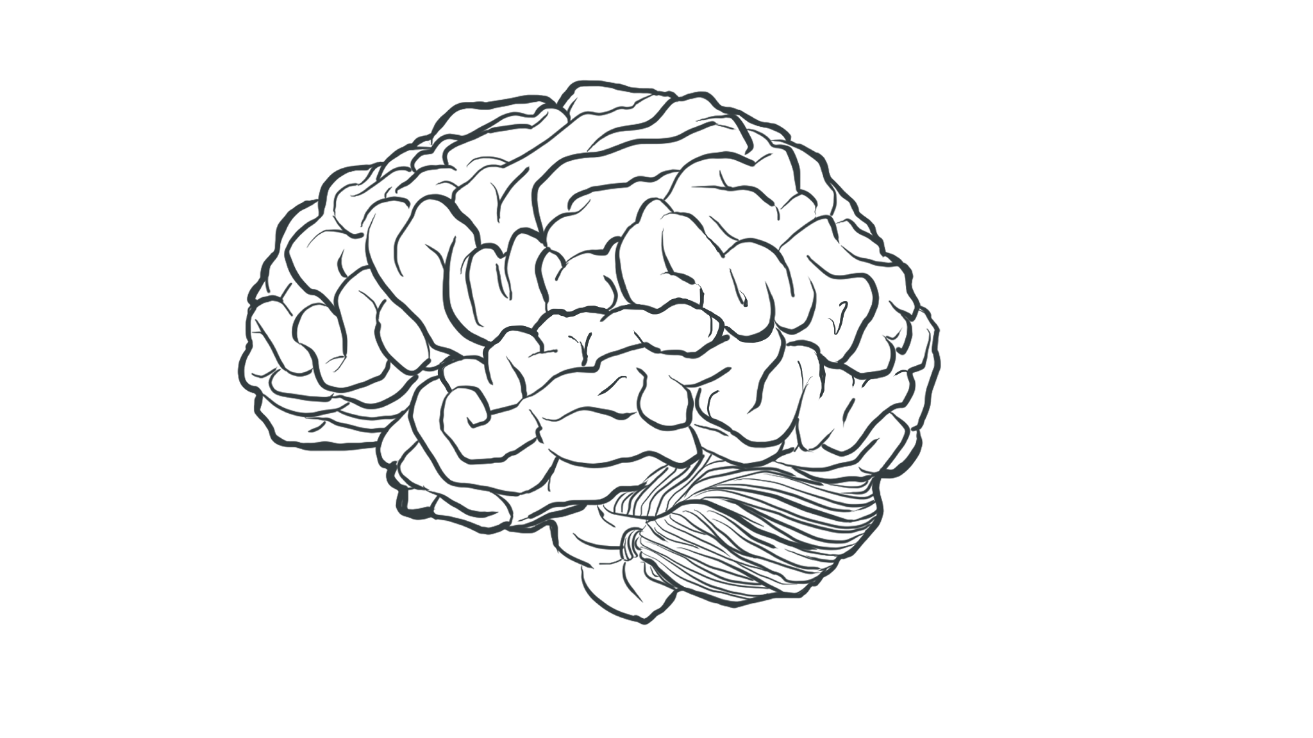
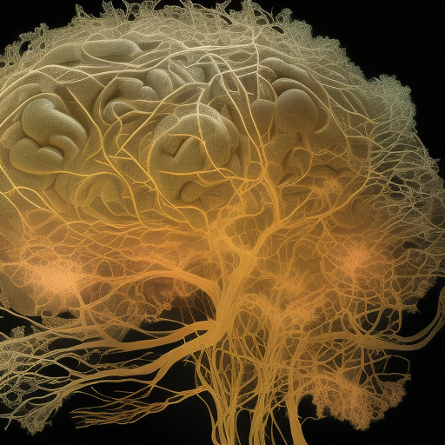
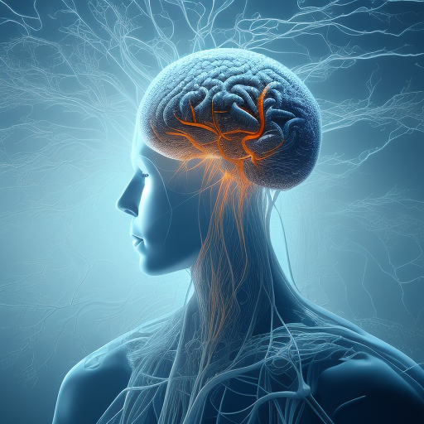
Thank you for listening!

Slide 15
References
Barch, D. M., Burgess, G. C., Harms, M. P., Petersen, S. E., Schlaggar, B. L., Corbetta, M., ... & Van Essen, D. C. (2013). Function in the human connectome: task-fMRI and individual differences in behavior. Neuroimage, 80, 169-189.
Sampaio, A., Soares, J. M., Coutinho, J., Sousa, N., & Gonçalves, Ó. F. (2014). The Big Five default brain: functional evidence. Brain Structure and Function, 219, 1913-1922.
Gray, J. R., & Braver, T. S. (2002). Personality predicts working-memory—related activation in the caudal anterior cingulate cortex. Cognitive, Affective, & Behavioral Neuroscience, 2(1), 64-75
DeYoung, C. G., Shamosh, N. A., Green, A. E., Braver, T. S., & Gray, J. R. (2009). Intellect as distinct from Openness: differences revealed by fMRI of working memory. Journal of personality and social psychology, 97(5), 883.
Waris, O., Soveri, A., Lukasik, K. M., Lehtonen, M., & Laine, M. (2018). Working memory and the Big Five. Personality and Individual Differences, 130, 26-35.
Öztekin, I., McElree, B., Staresina, B. P., & Davachi, L. (2009). Working memory retrieval: contributions of the left prefrontal cortex, the left posterior parietal cortex, and the hippocampus. Journal of cognitive neuroscience, 21(3), 581-593.
Curtis, C. E., & D'Esposito, M. (2003). Persistent activity in the prefrontal cortex during working memory. Trends in cognitive sciences, 7(9), 415-423.

